Slide 1
Addition Subtraction of Signed Numbers
CSE 430 – Assignment 3

Slide 2
Problem Statement
For this assignment you will need to implement the control logic for addition-subtraction of signed numbers using one FF per state method.
In this slide we will be going step by step of what we need to do to implement this control logic

Slide 3
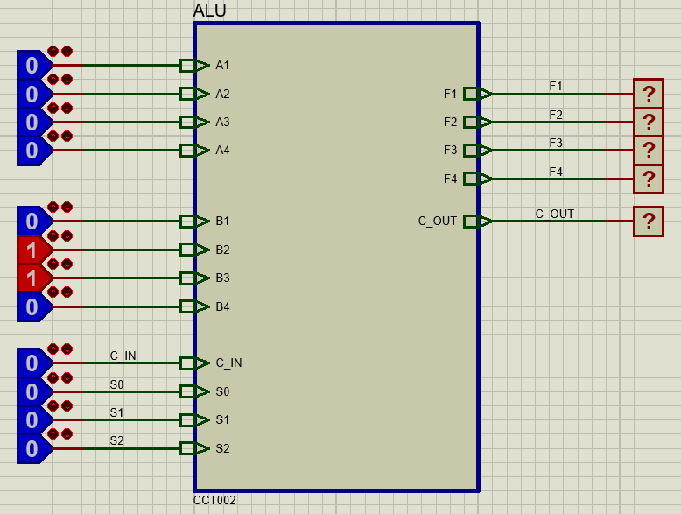
Step 1: ALU Sub-circuit

Slide 4
Step 2: Accumulator Sub-circuit
We don’t need our accumulator to implement many functions here. We just need it to load the output from ALU or hold it’s current value. For this we will be using a universal shift register (74194).
The shift register operates as follows-
S₁S₀ = 00 → Hold value
S₁S₀ = 11 → Parallel Load
Similar to the ALU we check if it can load and value as expected.
Once you have checked that, connect the ALU’s output to the accumulators input, and the accumulators output to the A input of ALU. Now check the components together.

Slide 5
Step 3: State transition
Since we will be using sequence register and decoder method here we need to find D inputs of the 8 flip flops. Consult the theory slide for this. The first is done here for you.
DT₀ = q_{a}‘q_{s}’T₀ + T₃ + ET₅ + T₇

Slide 6
Step 4: Implement transition logic
After the previous step, you will have 8 functions for the D inputs. Implement these functions and connect them to inputs of the 8 D flip-flops. The outputs of the 8 flip flops will represent each state.
Use q_{s}, q_{a}, E, S as logicstate inputs for now.
Once you are done, check the transition from state to state under different conditions of q_{s}, q_{a}, E, S.

Slide 7
Step 5: Implement the control signals
Output control functions
x = T₀
s₂ = T₆
s₁ = T₃ + T6
s₀ = T₃ + T₇
L = T₃ + T₄ + T₆ + T₇
y = T₁
z = T₇
w = T₅
Implement the control signals as the functions of the states.
Check the values with logicprobes when you are done.
Connect the control signals S₂, S₁, S₀, C_{in} to the ALU inputs, and L to Accumulator input. Now check if the ALU and the Accumulator perform the correct operations in the states T₃, T₄, T₆ and T₇.

Slide 8
Step 6: Implement A_{s}, B_{s} and E
Use JK flip flops to implement A_{s}, B_{s} and E (which means you no longer need logicstates for these) Use logicstates to load values onto A_{s} and B_{s} during T₀ state. Design the flip-flops to do the following operations-
y → complement B_{s}
z → complement A_{s}
L → E = C_{out}
w → E = 0
Signal | JA_{s} | KA_{s}
x = 1 | Input | Input’
z = 1 | 1 | 1
Signal | JB_{s} | KB_{s}
x = 1 | Input | Input’
y = 1 | 1 | 1
Signal | JE | KE
L = 1 | C_{out} | C_{out}’
w = 1 | 0 | 1

Slide 9
Bonus: Loading initial value onto the accumulator
Figure out how to load a value onto the accumulator from logicstates during T₀ state for some bonus marks.

Slide 10

Final Step:
You are good to go now, check the design for all possible scenarios in $\left(±A\right) ±(±B)$

Slide 11
Deadline
Section B: 12/08
Submit your Proteus files in ELMS.

